Slide 1
Bitcoin – nuts and bolts [scripts + network + blocks]

Slide 2
Scripts in practice
scripts let us determine conditions of payment
most nodes whitelist known scripts
99.9% are simple signature checks
~0.01% are MULTISIG
~0.01% are Pay-to-Script-Hash
remainder are mistakes
not much diversity at all

Slide 3
P2SH
Pay-to-Script-Hash
script specification
complex scripts
ease of use
pay to a value
efficiency gains
instead of sending coins to hash of this public key, send your coins to hash of this script
Notes:
-for instance, shopping at online marketplace, buyer may use MULTISIG
-this feature was added in later
-process – hash top value on stack, check whether it matches provided hash value,, execute a second step of validation – the top data value from stack is reinterpreted as a sequence of instructions and executed a second time as a script with rest of stack as input
-miners don’t need to maintain entire script in RAM, complexity is pushed to inputs

Slide 4
Escrow transactions
the purchase dilemma
third party
2-out-of-3 MULTISIG
OP_2 <A pubkey> <B pubkey> <C pubkey> OP_3 OP_CHECKMULTISIG
transaction
escrow
delivery of goods
redemption
dispute
Notes:
-Alice is making a purchase from Bob, she doesn’t want to pay until she receives the items, Bob doesn’t want to send until he has been paid
-they bring in Judy as an arbitrator
-coins are held in escrow on the blockchain
-this is all decentralized!

Slide 5
Green addresses
quick and/or offline transactions
third party
bank
‘green’ address
honesty guarantee
real-world guarantee
known address
history
reputation
Mt. Gox
Notes:
-Alice is making a purchase from Bob
-Bob may be offline and cant check blockchain for transaction
-or Alice may not be able to wait for six confirmations – suppose she wants food! E.g. Bob may be street vendor
-Alice requests bank to expedite a payment to Bob
-bank pays Bob accordingly from an address it controls
-bank pledges no double-spending
-only bank itself can do double-spend
-Alice shows Bob a transaction signed by the bank
-real-world guarantee – not cryptographic guarantee!
-the green address is very well-known
-bank will say – look at my past history, I haven’t done any double-spends before
-if bank is exposed, it will ruin its reputation
-address reuse pros and cons – compromise privacy – sender AND receiver – if you send to a public address, e.g. a gambling site, a political charity, etc.

Slide 6
micropayments
very small and continuous payments
tx fees!
combo payment
1. max. MULTISIG transaction
2. first payment – spend some coins, new tx
3. spend some more, new txs
4. terminate, send final tx
Bob signs and circulates
Input: x; Pay 42 to Bob, 58 to Alice
SIGNED(ALICE) SIGNED(BOB)
all of these could be double-spends!
Input: x; Pay 42 to Bob, 58 to Alice
SIGNED(ALICE)___________
...
Alice demands a timed refund transaction before starting
Input: x; Pay 04 to Bob, 96 to Alice
SIGNED(ALICE)___________
Input: x; Pay 100 to Alice, LOCK until time t
SIGNED(ALICE) SIGNED(BOB)
I’m done!
I’ll publish!
Input: x; Pay 03 to Bob, 97 to Alice
SIGNED(ALICE)___________
Input: x; Pay 02 to Bob, 98 to Alice
SIGNED(ALICE)___________
Input: x; Pay 01 to Bob, 99 to Alice
SIGNED(ALICE)___________
PROBLEM: Alice wants to pay Bob for each minute of phone service. She doesn’t want to incur a transaction fee every minute.
Bob
Alice
Input: y; Pay 100 to Bob/Alice (MULTISIG)
SIGNED(ALICE)
Notes:
-this could be for some streaming service, minutes-on-phone, Pay-as-you-go, etc.
-for max payment, Alice and Bob would both need to sign to redeem – coins effectively locked
-after first minute, Alice makes a transaction, spending one of the locked coins, returning rest to herself, and sends to Bob
-after second minute, Alice makes another transaction, spending another locked coin, returning rest to self, sends to Bob
-so on and so forth for every minute that she uses the service
-finally, she asks Bob to terminate the service and sends him a final transaction
-Bob signs and circulates, thereby redeeming funds
-can Bob use earlier transactions as double spends
-intermediate transactions are discarded – Bob has no benefit by publishing them – he loses money if he does

Slide 7
Lock time
micropayments
refund transaction
‘locked’
lock_t parameter
protection
{ "hash":"5a42590...b8b6b", "ver":1, "vin_sz":2, "vout_sz":1, "lock_time":0, "size":404,
...
}
transaction hash
housekeeping
not valid before
housekeeping
Notes:
-before micropayment protocol starts, Alice and Bob both sign a transaction which returns all of Alice’s money to her
-miners cannot publish this transaction until the block specified in that parameter has been mined
-if transaction published before then, it will be regarded as invalid and discarded
-this guarantees she cant retrieve her money while the micropayments protocol is underway
-if Bob violates protocol, she can publish this to get all her money back
-what happens if protocol executes fairly and then Alice publishes refund transaction?
-can Alice cheat? Not pay Bob for final payment?

Slide 8
blocks
why blocks?
overheads
data
mining overhead
consensus?
hash chain of blocks
hash tree within block
Notes:
-an optimization
-too much overhead if we were to add each transaction individually (data + mining overhead!)
-single unit of work for miners
-hash chain of blocks is MUCH shorter than hash chain of transactions (how?)
-consensus on each transaction would be crazy!
-verification would be much slower
-hash (Merkle) tree within block – to enable proof of membership property

Slide 9
blocks
block = header data + hash tree of transactions
Hash chain of blocks
prev: H( )
prev: H( )
prev: H( )
trans: H( )
trans: H( )
trans: H( )
H( ) H( )
Hash tree (Merkle tree) of transactions in each block
H( ) H( )
H( ) H( )
transaction
transaction
transaction
transaction

Slide 10
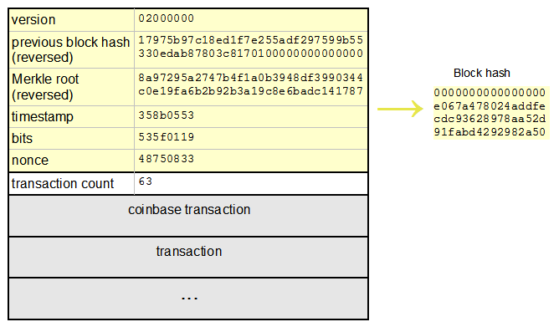
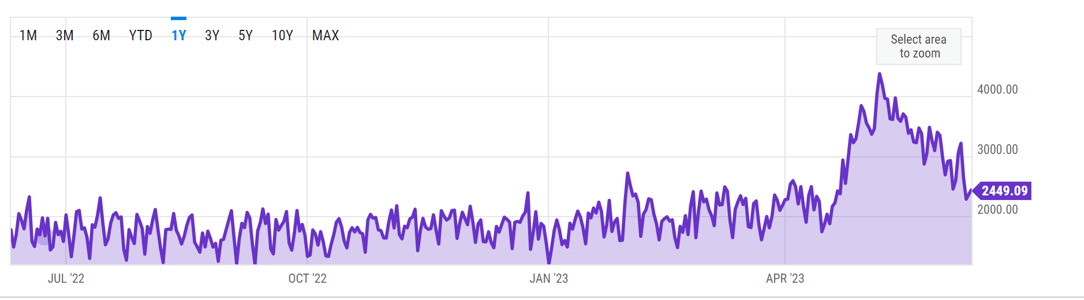
blocks
header
block hash
nonce
timestamp
difficulty level
mrkl_root
miners hash headers
Notes:
-for valid block, header has to start with x number of zeros as per difficulty
-why include difficulty level? So that person who downloads blockchain later can verify winning header is correct
-why is only header hashed during mining? Because hash is already a fingerprint of all transactions in block – and it would take too much energy to hash entire block.
The coinbase transaction is generated before the block is mined, not afterwards, because it must be included in the list of transactions just like all the others. It is the first transaction in the block, and its hash is used in exactly the same way as all the others when constructing the merkle root.
Once the coinbase transaction is created and the merkle root calculated, then the nonce is varied and the block is mined.

Slide 11
Coinbase transaction
"in":[ { "prev_out":{ "hash":"000000.....0000000", "n":4294967295 },
"coinbase":"..." }, "out":[ { "value":"25.03371419", "scriptPubKey":"OPDUP OPHASH160 ... ”
}
Null hash pointer
redeeming nothing
arbitrary
First ever coinbase parameter:
“The Times 03/Jan/2009 Chancellor on brink of second bailout for banks”
block reward
transaction fees
Notes:
-coinbase transaction creates new coins
-ALWAYS single input and single output
-input contains a NULL hash
-index n is always 0xFFFFFFFF (4294967295)
-value determined by algorithm
-special coinbase parameter – miner can put in any random information
-timestamping! Block mined *after* 3/1/2009

Slide 12
Bitcoin network
p2p, TCP
random topology
dynamic
bootstrap – seed node
flooding algorithm / gossip protocol
peers validate and forward
mempool
Notes:
-all nodes are equal, no master nodes, hierarchy, etc.
-if a node hasn’t been seen for 3 hours, other nodes start to forget it
-if a node gets a transaction that’s not in the blockchain, it validates, forwards, and stores it in mempool
-if it receives a transaction already in mempool, it doesn’t further broadcast it
-necessary so that flows terminate and loops don’t build in the network
-connect to seed node which introduces you to other nodes and so on and so forth

Slide 13
Bitcoin network
transaction checks:
transaction is valid
whitelist of scripts
outputs can be redeemed
fresh transaction
Notes:
-transaction is valid means format must be correct and scripts must return true
-super cautious on scripts since some have been known to cause errors
-outputs must not have been spent already
-if node receives transaction it has already seen, it doesn’t forward it
-why must *every* node do these checks for themselves?

Slide 14
Bitcoin network
5
Already heard that!
1
5
1
Hello World! I’m ready to Bitcoin!
7
7
8
8
getaddr()
getaddr()
1, 7
getaddr()
A→B
A→B
A→B
New tx!
A→B
3
3
6
A→B
6
2
2
A→B
A→B
A→B
4
A→B
A→B
4
A→B

Slide 15
Bitcoin network
transaction checks:
transaction is valid
whitelist of scripts
outputs can be redeemed
fresh transaction
block checks:
hash value correct
longest branch
Notes:
-hash value has to be valid and meet difficulty level
-node *only* forwards block if it is received on the longest branch – this minimizes forks building up
-checks on transactions in blocks?
-compare and remove for the most part! Only do transaction checks if there is a new transaction in the block

Slide 16
Bitcoin network
impossible to measure exactly
1 million IP addresses/month
5-10k permanent nodes (2015)
requirements escalating
UTXO set
distribution (link)
Notes:
-nodes require more and more storage and RAM as blockchain grows
-size was 10s of Gigs in 2015 – now 380 gigs in 2021 to store full blockchain
-also a lot of new cryptocurrencies out there that people would rather follow
As per 2021 12856 nodes
-UTXO set – unspent TX outputs maintained in RAM to speed up processing total transactions 850 millions as of today and unspent transactions are 104.3 M

Slide 17
limitations
hard-coded parameters
10 min. average creation time per block
1 M bytes in a block
20,000 signature operations per block
100 M satoshis per bitcoin
21M total bitcoins maximum
50,25,12.5... bitcoin mining reward
Notes:
-coin supply and reward will likely not change, financial implications are too great

Slide 18
limitations
throughput limits
1 M bytes of transactions per 10 minutes
average transaction size >250 bytes
7 transactions/second
Ethereum 30 transactions/seconds
Solana 65K transactions/seconds
PayPal – 50-100 transactions/second
VISA – 2-10k transactions/second

Slide 19
Hard forks
5
1
Block 24
Block 23
Block 23
7
8
Block 24
That’s crazy talk!!
Block 23
That’s crazy talk!!
Block 24
Block 23
24
I found a nifty new block!
3
6
24
2
Block 24
Block 23
Block 23
Block 23
24
4
24
Block 24
PROBLEM: Old nodes will never catch up
Block 23
Notes:
-hard forks – upgraded nodes recognize a block which older blocks do not
-in this case, Block 23 is as per old format, Block 24 is new
-no compromise – blockchain splits

Slide 20
soft forks
tighten validation rules
only some blocks will be rejected
new blocks valid for everyone
majority adoption
P2SH
new features
add useful metadata in coinbase parameter
Notes:
-interoperable with older nodes
-P2SH feature caused a soft fork
-old nodes: hash a data value and check if hash matches value in output script
-new nodes: addition step to running the output script to check script validity
-e.g. add UTXO tree in coinbase parameter

Slide 21
Hard forks
new op codes
switch from wasteful PoW
changes to hard-coded parameters
block size
mining rate, etc.
fixing bugs
very expensive
work *around* problems
new coins
Notes:
-bugs – e.g. the extra bit in MULTISIG instruction
-work around problems – like in real life!
-many of these fixes have been implemented and validated in newer coins

Slide 22
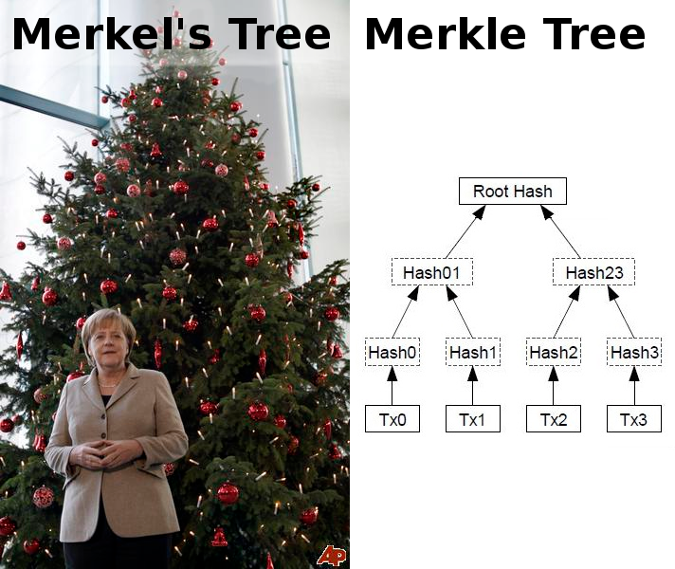
humor

Slide 23
Homework
Chap 3: Bitcoin Mechanics Bitcoin and Cryptocurrency Technologies: A Comprehensive Introduction
P2SH (link)
Blockchain exploration: blockchain.info (link)
Distribution of nodes (link)

